Slide 1
CLUSTERING ALGORITHMS
NANDHINI SHANMUGAVEL

Slide 2
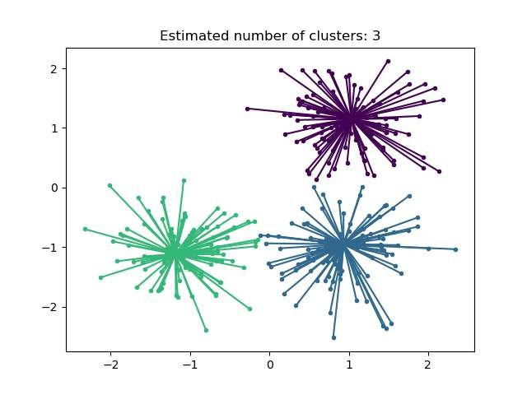
AFFINITY PROPAGATION CLUSTERING
Affinity Propagation is a clustering algorithm that does not require
the number of clusters to be specified.
It identifies exemplars (representative points) through message
passing between data points.
Every point is initially considered a potential cluster center.
The algorithm is deterministic – same input gives same output (no random init like K-Means).
Exemplars: Affinity Propagation identifies a small number of data points as "exemplars," which are representative of other samples within their respective clusters.

Slide 3
AFFINITY PROPAGATION CLUSTERING
Takes as Input:
A matrix of pairwise similarities between data points.
Core Process:
Responsibility (r):
“How well-suited is point k to be the center for point i?”
Availability (a):
“How likely should point i choose point k as its exemplar?”
These two messages are updated iteratively.
After convergence, a few data points are chosen as exemplars, and all other points are assigned to their closest one.
Result:
Natural, data-driven clusters without manually setting the number.

Slide 4

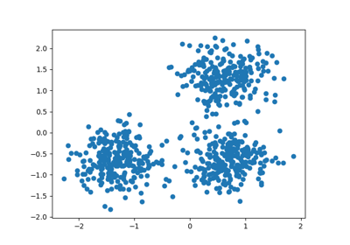
AFFINITY PROPAGATION CLUSTERING
Dataset: mall_customers.csv
Output: 10 clusters automatically detected.
Variants for Improvement:
Partition Affinity Propagation: Splits similarity matrix -> faster.
Adaptive AP: Prevents oscillation, better convergence.
Fuzzy Statistic AP: Uses fuzzy logic to reduce number of
clusters.

Slide 5
AFFINITY PROPAGATION CLUSTERING
Advantages:
No need to predefine clusters.
More accurate than K-Means in some cases.
Deterministic results (no random runs).
Limitations:
High memory use due to full similarity matrix (O(N²)).
Slower for large datasets.
Number of clusters not controllable.

Slide 6
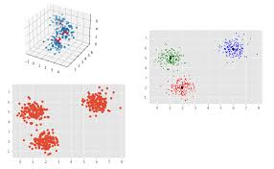
MEAN-SHIFT CLUSTERING
Mean Shift is a centroid-based clustering algorithm that locates
modes (peaks) of a density function to form clusters.
Unlike K-Means, it does not require the number of clusters as
input.
It works by iteratively shifting each point towards the highest
density region in its neighborhood.
The algorithm uses a kernel density estimation (KDE) to
estimate density gradients.
The only required parameter is bandwidth, which controls the
neighborhood size.

Slide 7
MEAN-SHIFT CLUSTERING
Steps:
Initialize: Treat each data point as a candidate centroid.
For each point, compute the mean of points within its neighborhood (based on bandwidth).
Shift the point to this mean — move towards higher density.
Repeat until points converge (no movement).
Merge nearby converged points to form final cluster centers.
Key Parameter: bandwidth
Controls radius of neighborhood.
Can be estimated using sklearn.estimate_bandwidth() based on data.
Affects:
Number of clusters.
Smoothness of KDE.
Speed and stability.

Slide 8

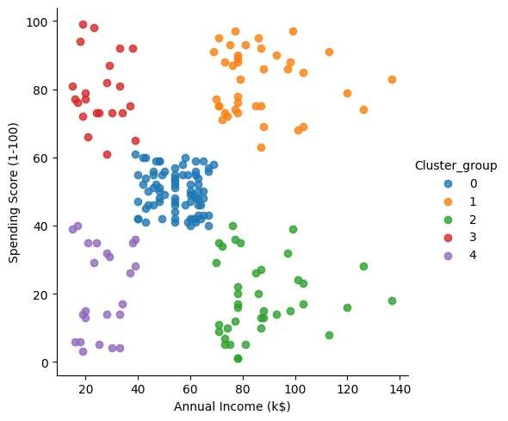
MEAN-SHIFT CLUSTERING
Dataset: mall_customers.csv
Output: 5 clusters automatically detected.
we’re applying the Mean Shift algorithm with a bandwidth of 25. This value defines the neighborhood radius used to shift points toward high-density regions. The result, y_MS, contains the cluster assignments for each data point.”

Slide 9
MEAN-SHIFT CLUSTERING
Advantages:
No need to set number of clusters.
Handles non-linear, non-convex cluster shapes.
Robust to outliers and noise.
No model assumptions — purely data-driven.
Avoids local minima (unlike K-Means).
Cluster boundaries are adaptive to density.
Disadvantages:
Poor scalability for large/high-dimensional datasets (O(N²)).
Bandwidth selection is critical and non-trivial.
Cannot differentiate between meaningful vs. noisy modes.
Slower than K-Means, especially without binning.

Slide 10
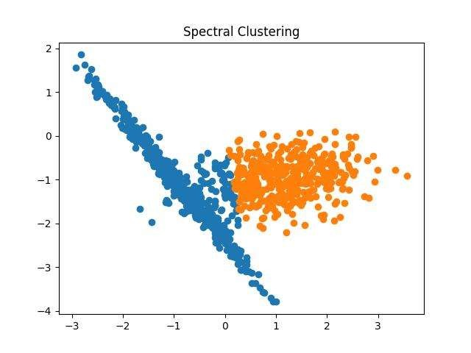
SPECTRAL CLUSTERING
Spectral Clustering views the dataset as a graph, where:
Each data point is a node
Edges represent similarities between points (via kernel or
similarity matrix)
The goal: partition the graph into clusters by minimizing edge
cuts between groups.
Converts the similarity graph into a Laplacian matrix.
Uses eigen decomposition (spectrum) to embed data into a
space where clusters are easier to separate.

Slide 11
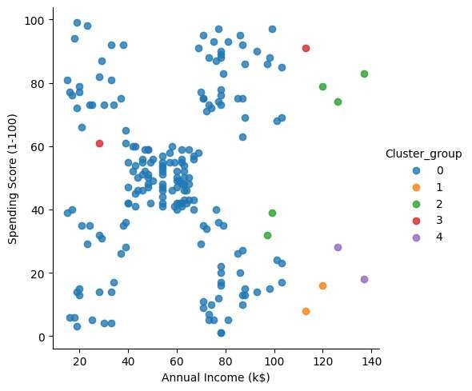
SPECTRAL CLUSTERING
Dataset: mall_customers.csv
Output: 5 clusters automatically detected
No assumptions about cluster shape.
Works well with non-convex and complex structures.

Slide 12
SPECTRAL CLUSTERING
Advantages:
Effective on high-dimensional data.
Works with irregular shapes.
Can be adapted for mixed data types using similarity graphs.
No need for distance metrics like Euclidean.
Disadvantages:
Slow for large datasets (due to eigen decomposition).
Requires pre-specifying the number of clusters.
Sensitive to choice of similarity graph (e.g., nearest neighbors or RBF kernel).

Slide 13
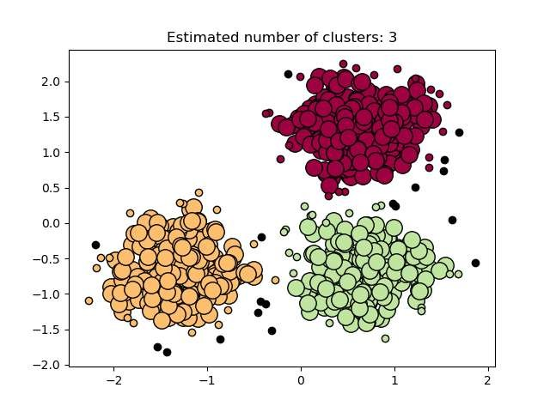
DBSCAN CLUSTERING
What is DBSCAN?
DBSCAN stands for Density-Based Spatial Clustering of Applications with Noise. It groups together
closely packed data points and identifies sparse regions as outliers.
Key Ideas:
A cluster = dense region in data space.
Separates clusters by areas of lower density.
Does not assume spherical clusters (unlike K-means).
Automatically detects noise and non-convex shapes.
Core Point: Has ≥ min_samples within eps radius.
Border Point: Near a core point but not dense itself.
Noise Point: Too isolated to belong to any cluster.

Slide 14
DBSCAN CLUSTERING
Steps:
Pick eps (neighborhood radius) and min_samples (minimum neighbors to form a core point).
For each data point:
If it has ≥ min_samples within eps, it becomes a core point.
Clusters are formed by connecting density-reachable core and border points.
Points that don’t belong to any cluster are marked as noise.

Slide 15

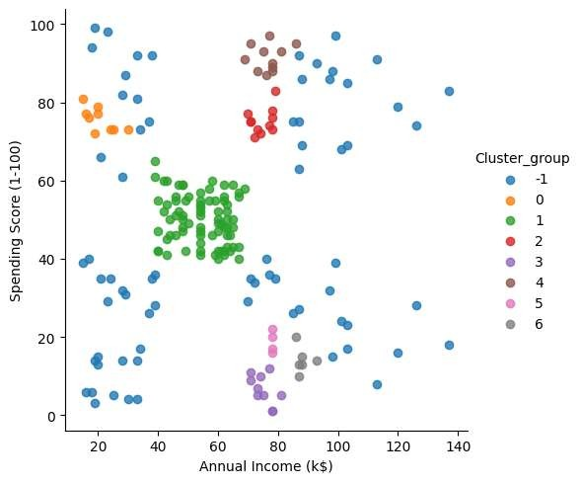
DBSCAN CLUSTERING
Parameter Tuning:
eps: Controls neighborhood size
Too small -> many outliers Too large -> clusters merge
min_samples: Minimum neighbors to form a core
point
Rule of thumb: min_samples ≥ D + 1 (D = number of dimensions)

Slide 16
DBSCAN CLUSTERING
Advantages:
Can detect clusters of arbitrary shape (e.g. moons, spirals, rings)
Robust to noise and outliers (unlike K-means)
No need to pre-specify number of clusters
Works well for spatial data, geospatial, or low-dimensional cases
Disadvantages:
Struggles with varying densities - May fail if one cluster is sparse and another is
dense.
Not ideal for high-dimensional data - Curse of dimensionality makes distance
less meaningful.
Sensitive to eps and min_samples - Needs tuning or trial-and-error.

Slide 17
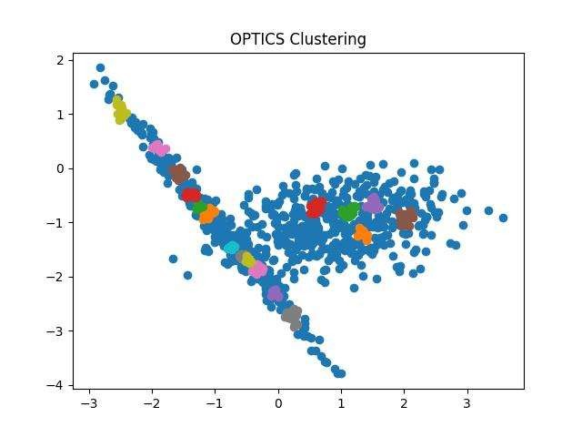
OPTICS CLUSTERING
OPTICS = Ordering Points To Identify Cluster Structure
A density-based clustering algorithm like DBSCAN, but more powerful for varying density clusters.
Key Concepts:
Builds an ordered list of data points based on density structure.
Each point is assigned a reachability distance:
Low = easy to reach (likely in same cluster)
High = far from other dense regions (possibly noise or
boundary)
The reachability plot visualizes the clustering hierarchy.
Main Goal:
Identify density-connected clusters without needing a fixed eps
value.
Works well with non-spherical and nested cluster shapes.

Slide 18

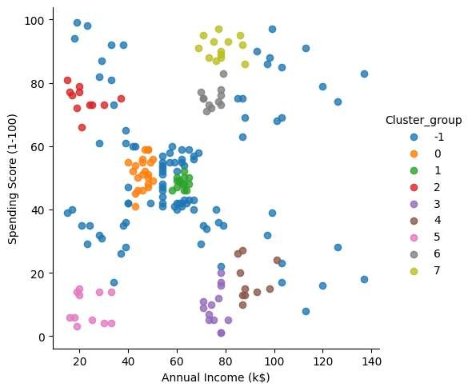
OPTICS CLUSTERING
Each point in the list is associated with a reachability distance, which is a measure of how easy it is to reach that point from other points in the dataset. Points with similar reachability distances are likely to be in the same cluster.

Slide 19
OPTICS CLUSTERING
Advantages:
No need to set number of clusters in advance.
Handles clusters of any shape, including non-convex.
Works well with varying density clusters (better than DBSCAN).
Useful for exploratory analysis with reachability plots.
Disadvantages:
Fails if clusters are not clearly separated by density drops.
Slower runtime and higher memory usage (Min-Heap, reachability
computation).
Requires domain knowledge to set min_samples and xi effectively.
Less popular -> fewer tools for automatic cluster extraction.

Slide 20
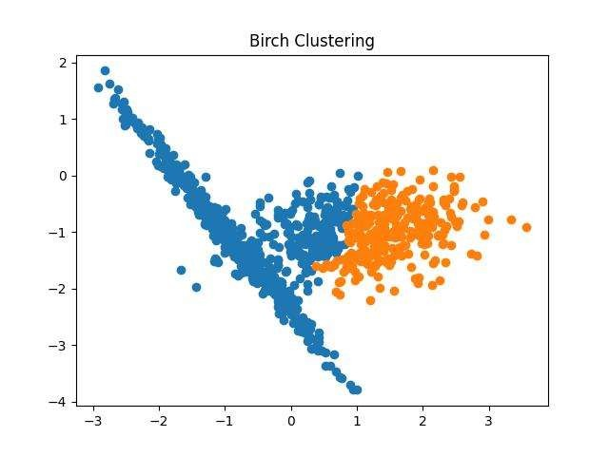
BIRCH CLUSTERING
BIRCH – Balanced Iterative Reducing and Clustering using Hierarchies
Why BIRCH?
Efficient clustering for large datasets with limited memory
Outperforms K-Means in scalability and incremental learning
BIRCH is a two-phase clustering algorithm:
Phase 1: CF Tree Construction
Phase 2: Global Clustering

Slide 21
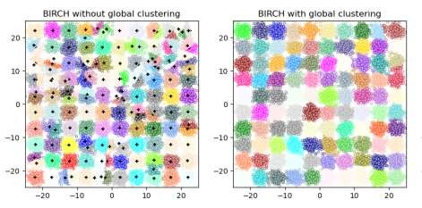
BIRCH CLUSTERING
Phase 1: CF Tree Construction
Data is incrementally inserted into a CF Tree (Clustering Feature Tree)
Each node contains CF entries = compact summaries:
CF=(N,LS,SS)CF = (N, LS, SS)CF=(N,LS,SS)
NNN: number of data points
LSLSLS: linear sum
SSSSSS: squared sum
The tree is built using:
threshold: Max radius for a subcluster
branching_factor: Max number of children per node
Phase 2: Global Clustering
Apply a standard algorithm (e.g., Agglomerative, KMeans) to leaf entries
If n_clusters is set:
Final clustering is done via global algorithm
If n_clusters=None:
CF Tree is the final result (online/incremental use case)

Slide 22

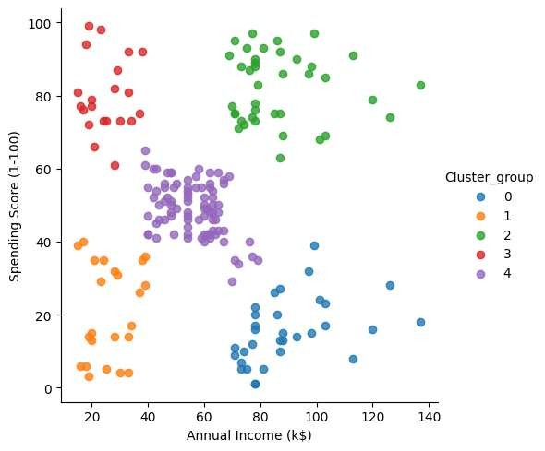
BIRCH CLUSTERING
Parameters:
threshold: Max cluster radius before a new subcluster is formed
branching_factor: Controls CF Tree width
n_clusters: Number of final clusters or None
to skip global step

Slide 23
BIRCH CLUSTERING
Advantages:
Handles large-scale and streaming data
Works incrementally and dynamically
Efficient: often requires just one scan of the data
Scikit-learn implementation supports multi-dimensional inputs
Limitations:
Only works with numerical, metric data (Euclidean space)
Sensitive to threshold; poor tuning leads to under-/over-clustering
Less effective for non-globular or highly overlapping clusters
No support for categorical features

